Slide 1
What is RMI?
Remote Method Invocation
  A true distributed computing application interface for Java, written to provide easy access to objects existing on remote virtual machines
  Helps provide access to objects existing on remote virtual machines

Slide 2
What is RMI? cont.
Remote Method Invocation
  Remote objects can be treated similarly to local objects
  Handles marshalling, transportation, and garbage collection of the remote objects
  Became part of the JDK with version 1.1

Slide 3
What is RMI not?
Not an all-purpose ORB architecture like CORBA and DCOM
Not language independent
  Limited only to Java
  Interfaces to remote objects are defined using ordinary Java interfaces (rather than having to use a special purpose interface definition language)
  Can provide more advanced features like serialization and security

Slide 4
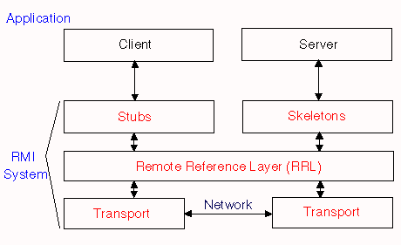
Support for the interface

Slide 5
Interface Support Layers
Stub/skeleton layer
  Responsible for managing the remote object interface between the client and server
Remote reference layer
  Responsible for managing the "liveliness" of the remote objects
  Manages the communication between the client/server and virtual machines

Slide 6
Interface Support Layers, cont.
Transport layer
  Actual network/communication layer that is used to send the information between the client and server over the wire
  Currently TCP/IP based
Uses serialization and remote procedure call to send information back and forth between remote objects

Slide 7
Interface Support Layers, cont.
Transport layer uses a hierarchy
  Initially tries to establish an ordinary socket connection between client and host
  If that fails, it tries HTTP
  Finally, it will try to use a cgi-script on the server and POST the data

Slide 8
Create the Interface Definition
First thing: define the interface
  Interface defines what remote methods and variables are going to be exported from the remote object.
  Remote interface must adhere to certain limitations:
    must be public
    must import the java.rmi.* package
    must extend the java.rmi.Remote interface

Slide 9
Create the Interface Definition
  Limitations, cont.:
    all exported methods must throw an RMI remote exception to manage errors during invocation
    all references to remote objects must be references to the interface (not to the remote object itself)

Slide 10
Implement the Interface Definition
Next, implement the remote interface
  Limitations:
    must implement at least one remote interface
    must import the java.rmi.server.* package
    must extend java.rmi.server.UnicastRemoteObject
    must install a security manager
    must create at least one instance of a remote object (for instance itself)
    must register at least one of the remote objects with the RMI remote object registry

Slide 11
Creating the Stubs/Skeletons
Stubs and skeleton code generated by using the rmic compiler
  rmic compiler creates stub and skeleton classes
  *_Stub and *_Skel classes are where the references to the remote objects will resolve to in the client's address space
  RRL will manage the mapping of these objects to the server's address space

Slide 12
Client
Must import java.rmi package and java.rmi.RMISecurityManager
Client must register with a security manager
  RMI Security Manager
    Constitutes the “sandbox” where Java applets reside
  Loading of classes
    Classes loaded from the network cannot be trusted
    If no security manager exists, only classes from the local file system will be loaded

Slide 13
Client, cont.
After registering the security manager
  create a URL string that is comprised of the server name and remote object name you are requesting
    rmi://my.host.edu/myServer
    “myServer” is the remote object
  enables the client to look up the remote object on the server via the rmiregistry

Slide 14
Client, cont.
Once the remote reference is made
  Client can invoke remote methods on the remote object
  The remote object is then treated as if it were a local object

Slide 15
Server
Has the same requirements as the client regarding the security manager
Once the server has registered with the security manager, it must create an instance of the remote object it wants to export

Slide 16
Server, cont.
RMIRegistry
  Must be running on the server
  Objects registered through this
  Clients are given access to remote objects through this
Since the server uses the rmiregistry, you must bind (i.e., alias) an instance of the object with the name that will be used to look up the object

